Slide 1
9/15/2025

Slide 2
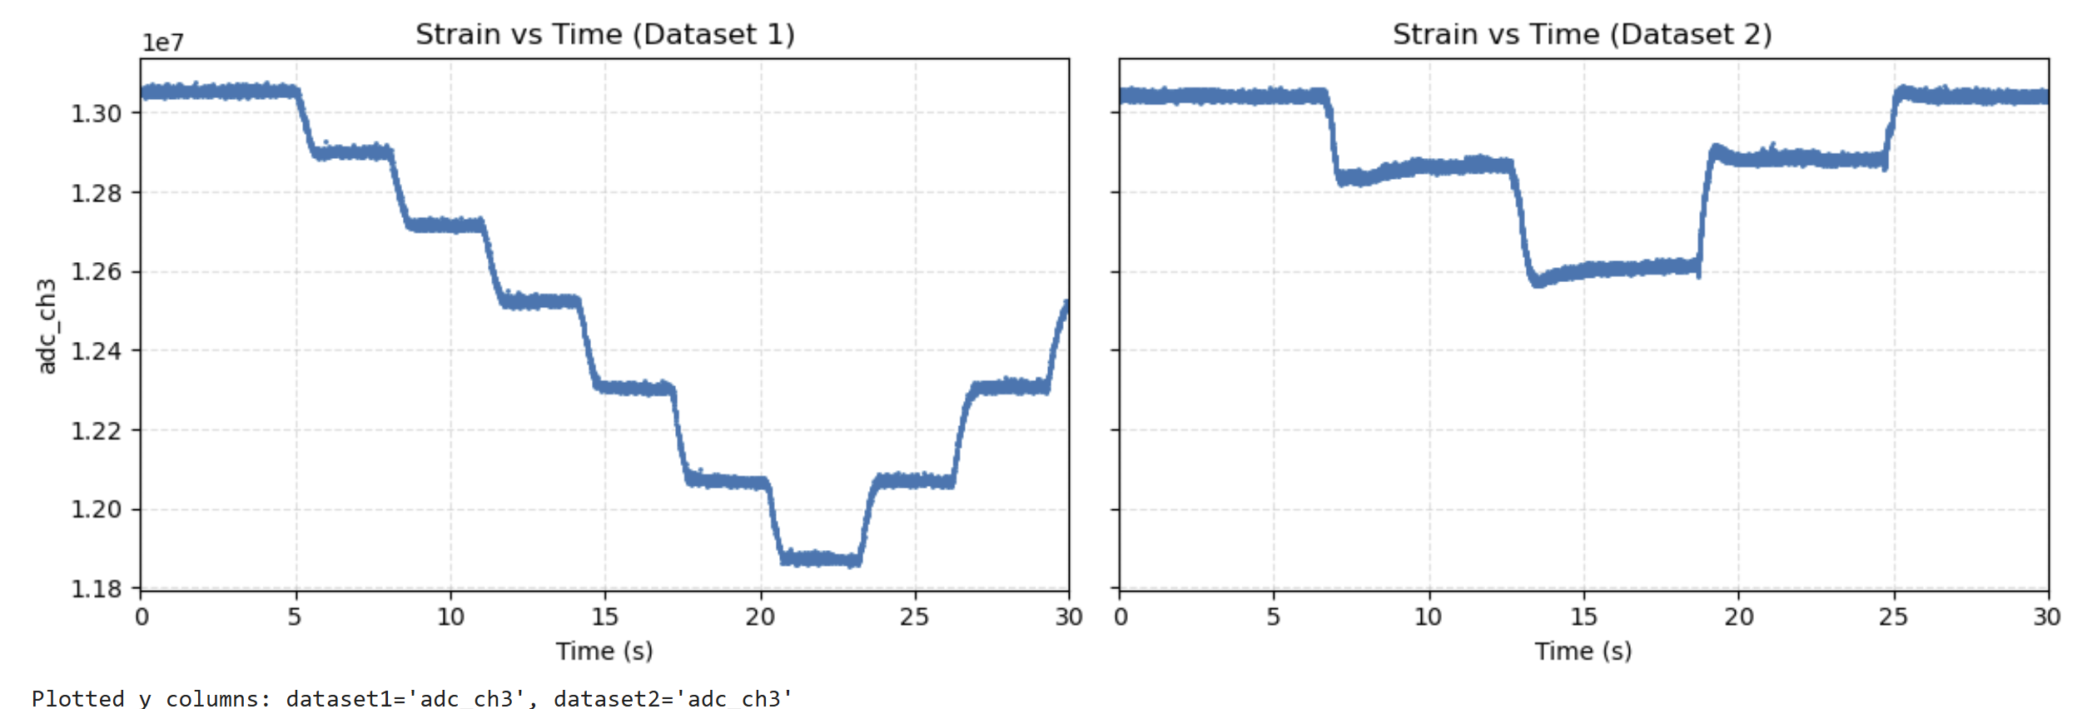
1st Autobender Strain Calibration
1st Hand on Autodender Strain Calibration

Slide 3
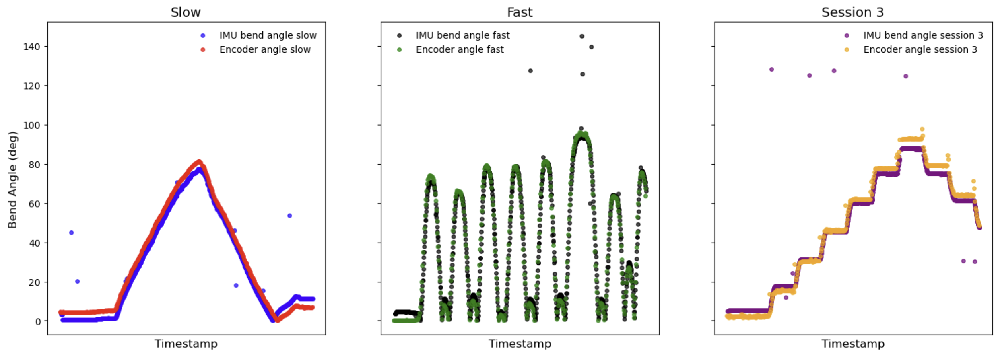
IMU’s on Autobender

Slide 4
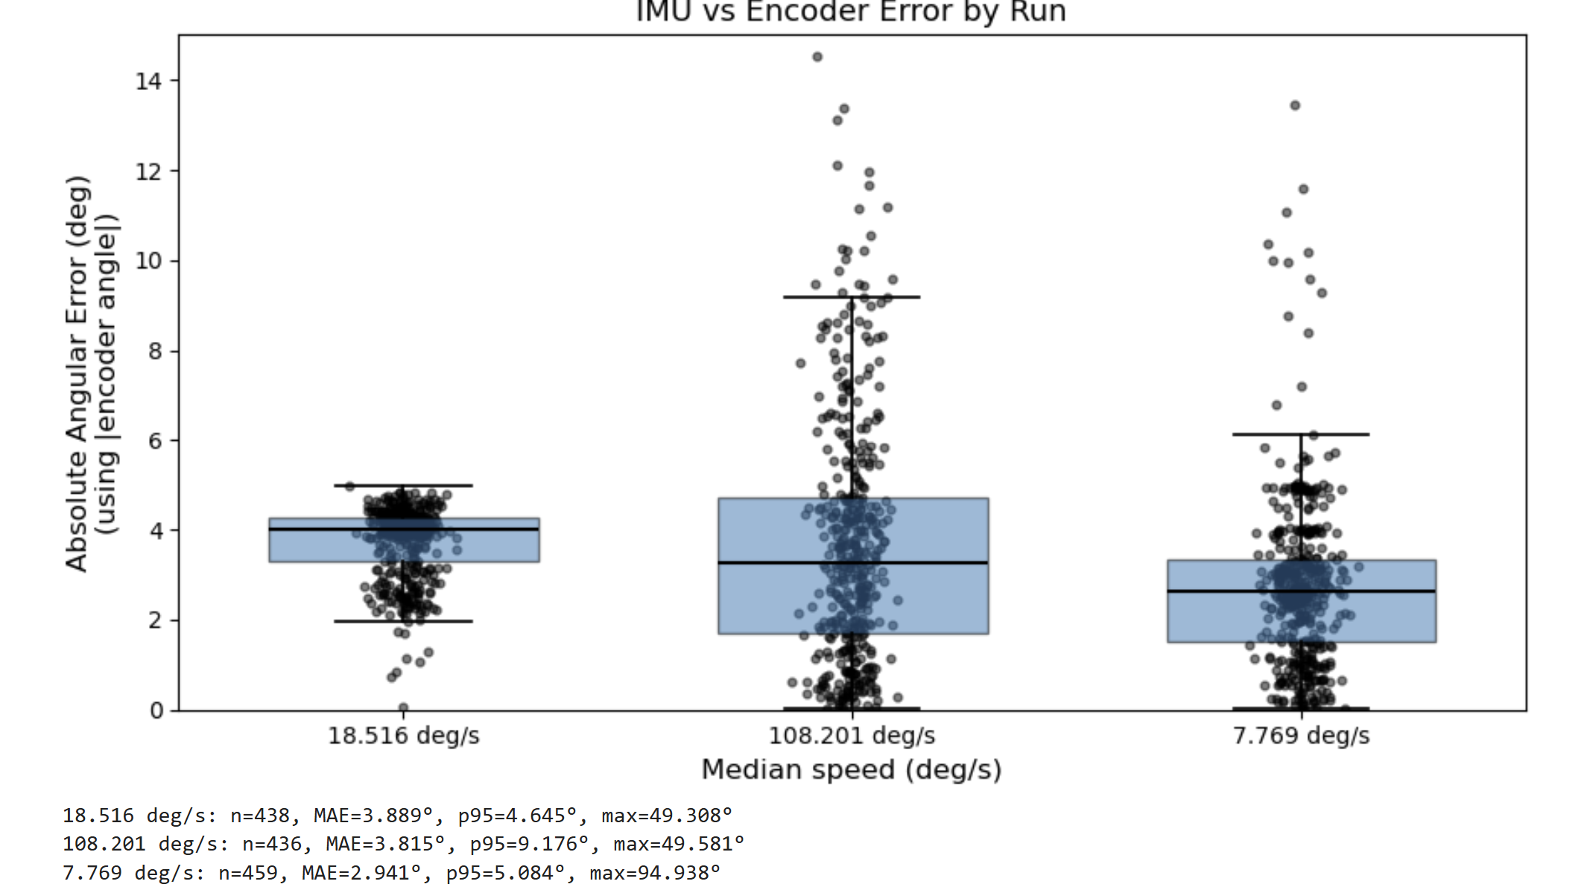
IMU’s on Autobender

Slide 5
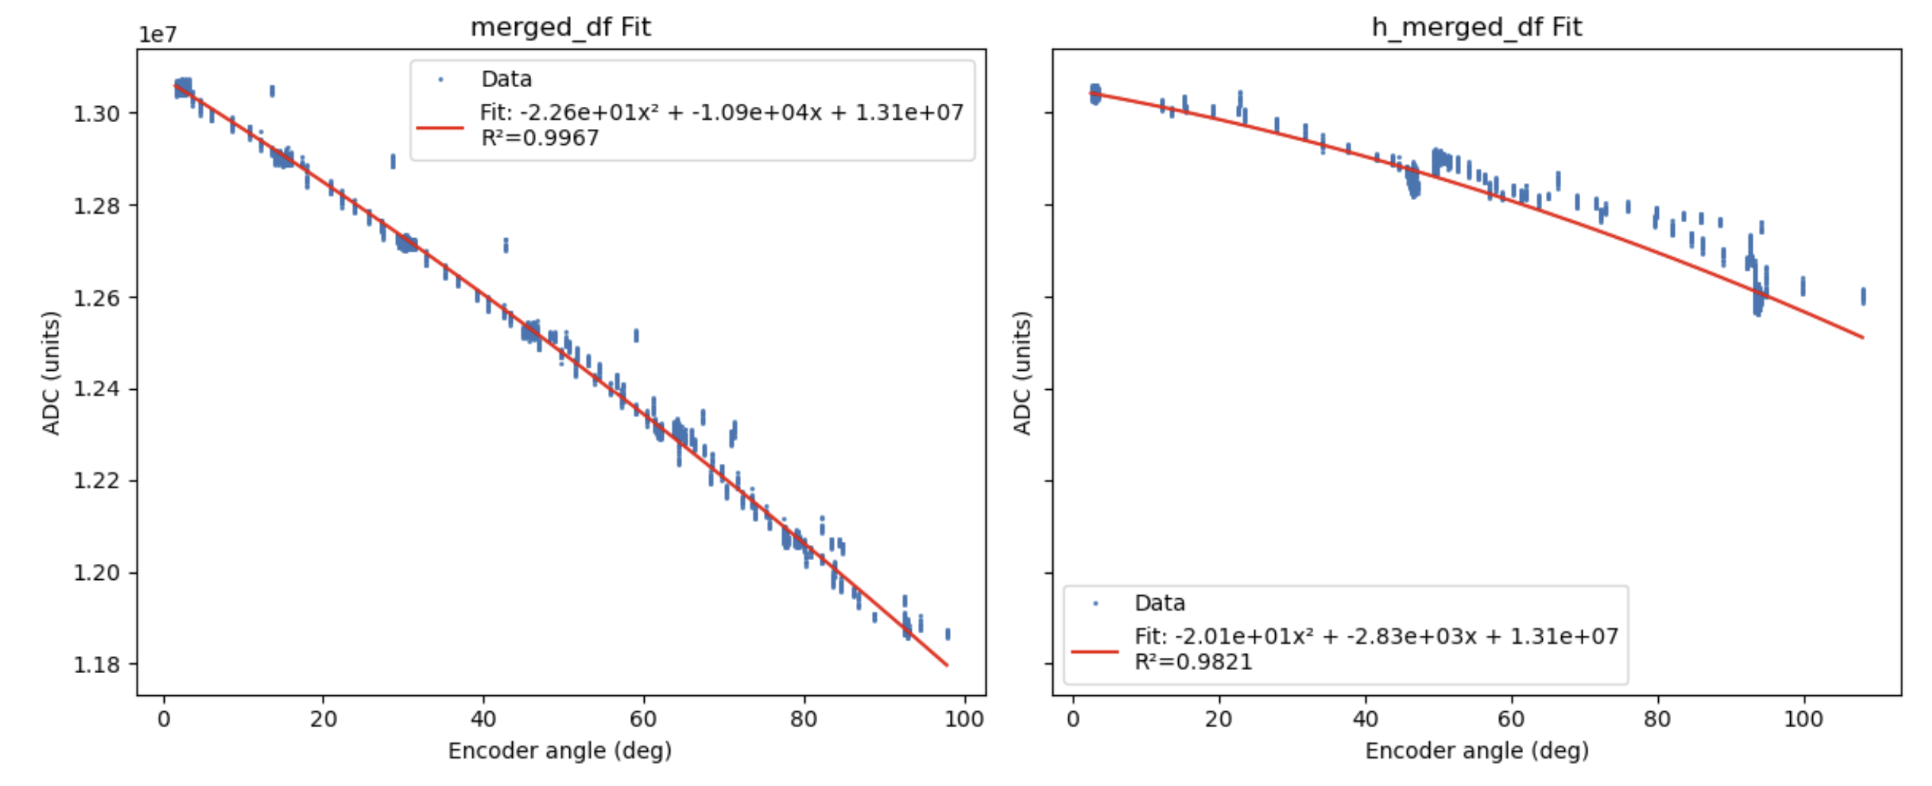
1st Autobender Strain Calibration Curve Fit of Raw Data
1st Hand on Autodender Strain Calibration
Curve Fit of Raw Data
If not including data between autobender jumps (data recorded continuously, unlike autobender studies last year where data only recorded every 15 degs), curve fit improves drastically.

Slide 6
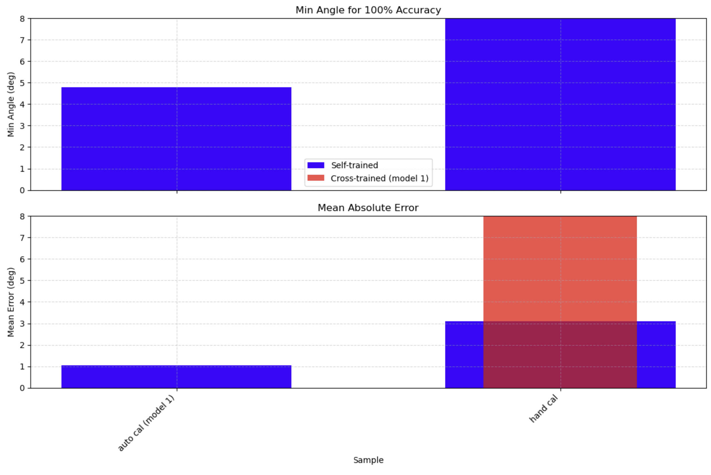
Autobender Norm 0 to 1 model used to fit Hand Norm 0 to 1 Data, as in previous data

Slide 7
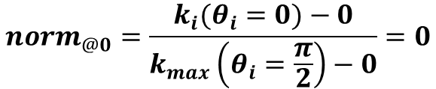
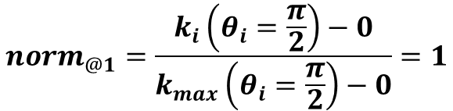
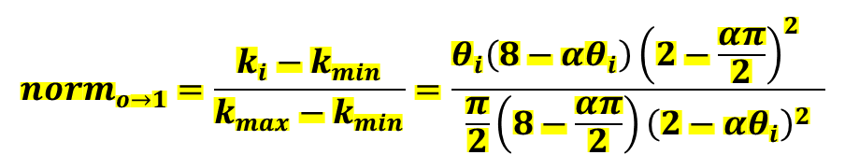
$$ε=αθ, where α=\frac{c}{L} , epsilon=strain or\frac{ΔL}{L}, c=knuckle radius, L=sample length$$
$$\frac{ΔR}{R_{o}}=\frac{ρLε}{whR_{o}}\left[\frac{8−ε}{{\left(2−ε\right)}^{2}}\right]=k, where R_{o}=initial resistance$$
$$norm_{o→1}=\frac{k_{i}−k_{min}}{k_{max}−k_{min}}=\frac{θ_{i}\left(8−αθ_{i}\right){{\left(2−\frac{απ}{2}\right)}^{2}}^{}}{\frac{π}{2}\left(8−\frac{απ}{2}\right){\left(2−αθ_{i}\right)}^{2}}$$
$$norm_{@1}=\frac{k_{i}\left(θ_{i}=\frac{π}{2}\right)−0}{k_{max}\left(θ_{i}=\frac{π}{2}\right)−0}=1$$
$$norm_{@0}=\frac{k_{i}(θ_{i}=0)−0}{k_{max}\left(θ_{i}=\frac{π}{2}\right)−0}=0$$

Slide 8
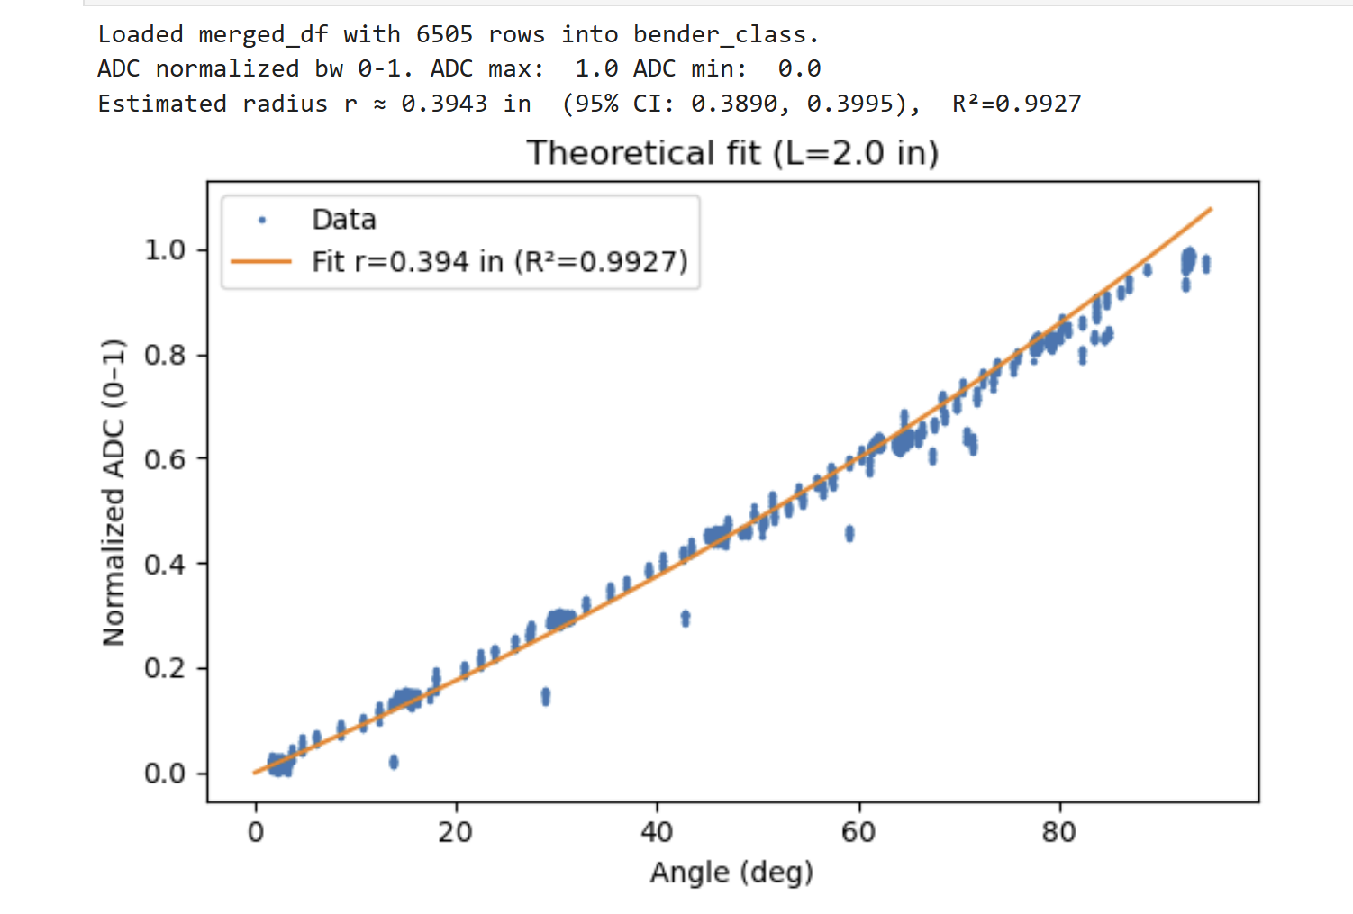
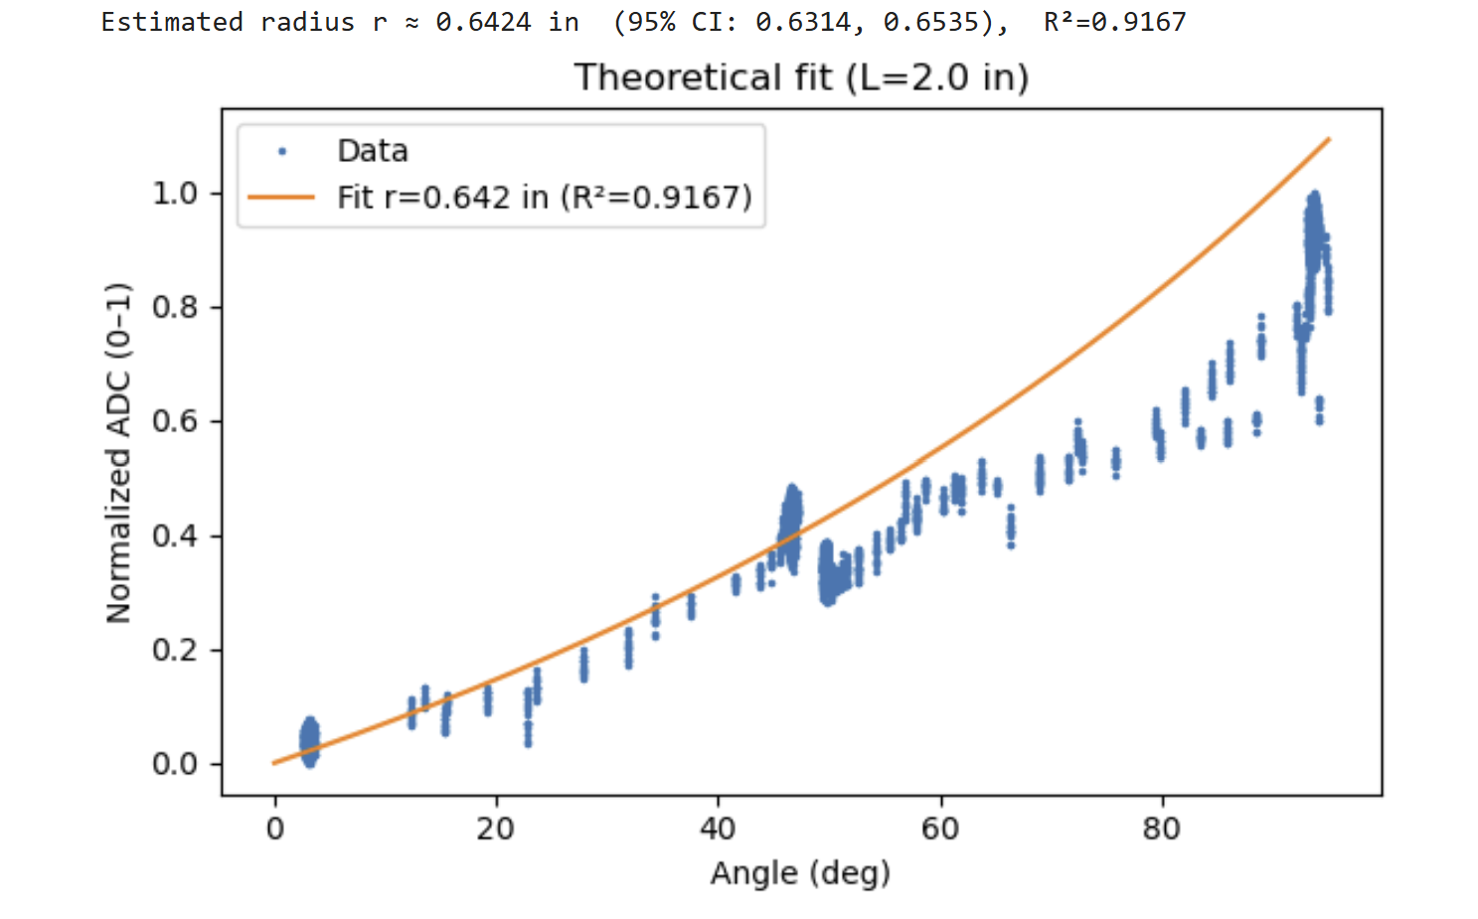
Theoretical Model used To Fit Autobender (Left) and Hand (Right) Data
1st Autobender Theor Curve Fit of Raw Data
1st Hand on Autodender Theor
Curve Fit of Raw Data

Slide 9
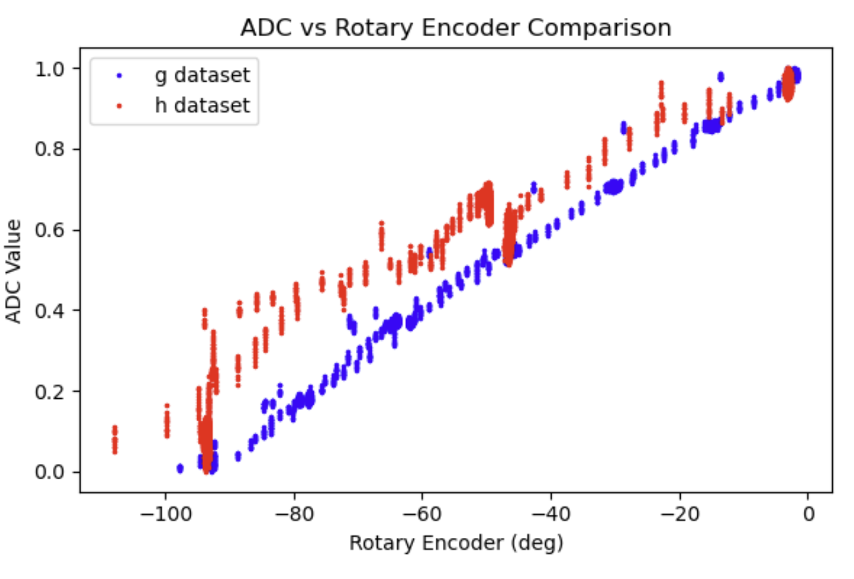

Slide 10
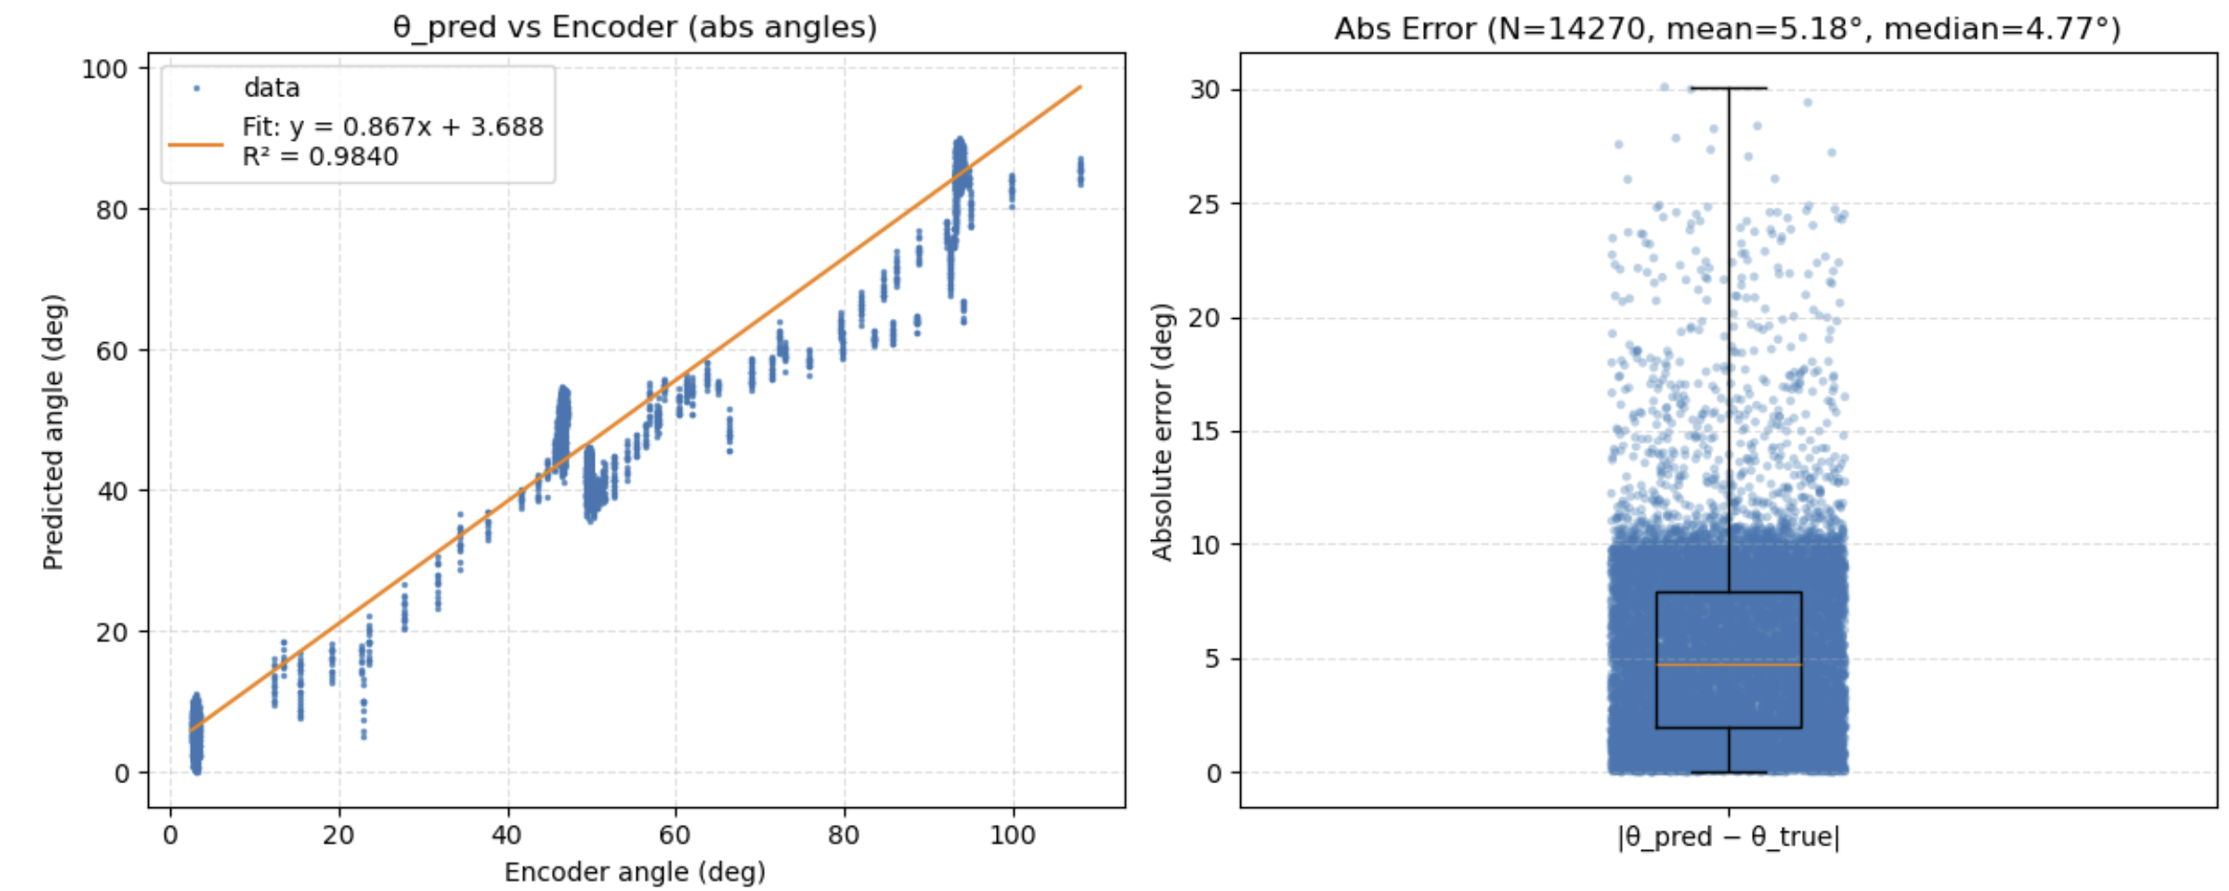

Predicted Angle Based on Measured Knuckle Radius
From raw adc
Measured Radius
$$norm_{o→1}=\frac{θ_{i}\left(8−αθ_{i}\right){{\left(2−\frac{απ}{2}\right)}^{2}}^{}}{\frac{π}{2}\left(8−\frac{απ}{2}\right){\left(2−αθ_{i}\right)}^{2}}$$
Abs Error

Slide 11
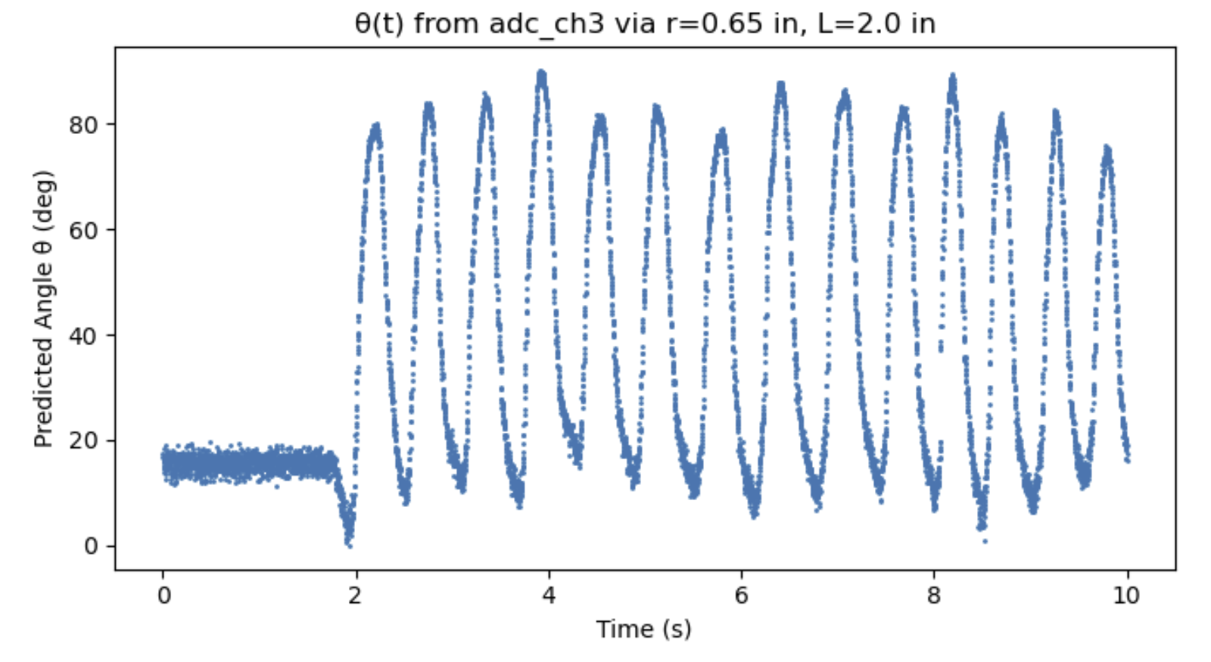
1 Trial of Bending Finger AFAP

